Slide 1
ADS ML – Week 2 Reproducible Research & Exploratory Visualization with Matplotlib

Slide 2
Goals: At the end of this lesson …
You have created your personal portfolio.
You know how to apply the rules of reproducible research to your iPython notebooks.
You can create all parts for a scientific plot in Python with Matplotlib.
You can create/recreate simple scatter, histogram, line plots and heatmaps.
Notes:
The WHYS:
* Portfolio in Git to keep all your work safe, together and accessible to lecturers.
Reproducible research ensures that the lecturers and the future you can follow your steps, and no steps or modifications are hidden.
Creating correct labels etc. ensures that you know what you are plotting, as well as your viewers.
These are some of the most common plots in the exploratory phase.

Slide 3
Contribution to the learning objectives
create a visualization from any data set that is not misleading and that clearly shows clustering, outliers and trends,
motivate every design choice in a created visualization,
motivate the next step in a data analysis based on a given visualization,
present data analysis and visualizations as part of reproducible research,
apply narrative techniques in visualizations,
create engaging visualizations that allow for data exploration and story progression.

Slide 4
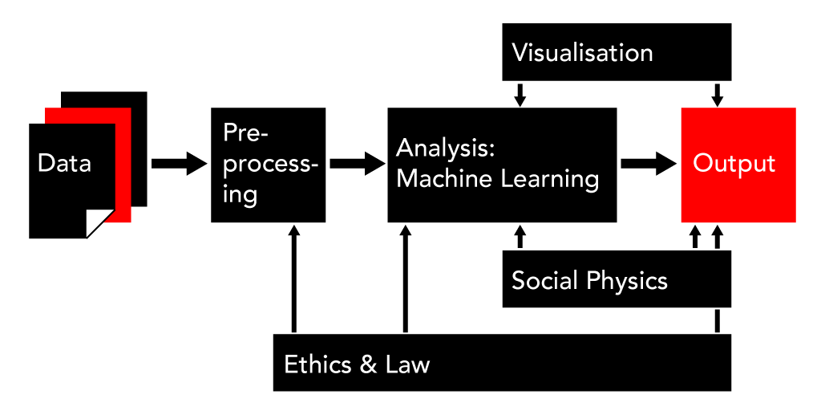
What are we doing?
Exploration
Presentation

Slide 5
Reproducible Research Warning: heavy text slides ahead

Slide 6
Reproducible Research
Reproducible research means that someone else could, in principle, redo all your actions. Reproducible research is all about transparancy.
It has nothing to do with correctness or reliability. Your research can be reproducible, yet completely false, unreliable and drawing the wrong conclusions. So why is it important then?

Slide 7
Reproducible Research
Reproducible research is important because, even though you can never guarantee that your work is correct, you at least ensure that others have full insight into what you have done.
Your lecturers can assess your work, and the company that wants to use your result can build further on your work.
In this minor we advise you to use a quite specific workflow to create reproducible research.

Slide 8
Reproducible Research Rules
Use iPython Notebooks to combine your report with source code and its output.
Use a version control system (Git is recommended).
Include all data used in the data analysis in its rawest form and include a codebook when possible.
You will NOT change the raw data by hand but in a Notebook.
You will NOT use a GUI based program to edit or visualize data and include it as reproducible research. You can use such tools for data exploration or to produce more esthetic visualizations based on reproducible visualizations.
Intermediate results can only be used if there is a Notebook creating them.
Based on:https://github.com/rdpeng/courses/blob/master/05_ReproducibleResearch/lectures/Checklist.pdf

Slide 9
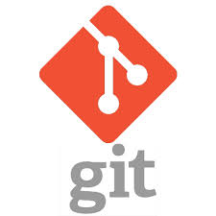
Assignment: Setting up your portfolio
Set up your personal private digital portfolio at:
https://git.fhict.nl/ or (private) https://github.com/ or …
New at Git?
https://www.udacity.com/course/how-to-use-git-and-github--ud775
(lesson 2) or
https://www.youtube.com/watch?v=Y9XZQO1n_7c
Notes:
Click on car to show movie

Slide 10
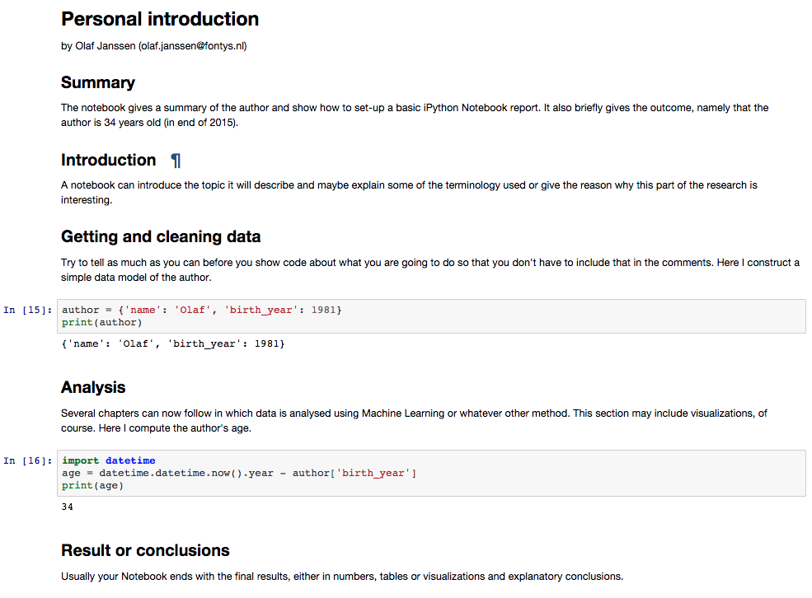
Reproducible iPython Notebooks
https://github.com/olafjanssen/ads-dv
Notes:
See Git of course. Show that you can use MarkDown to create proper report style Notebooks. Remind them to add authorship to discern group work from individual work.

Slide 11
Plotting with Matplotlib & All the Parts of a Chart

Slide 12
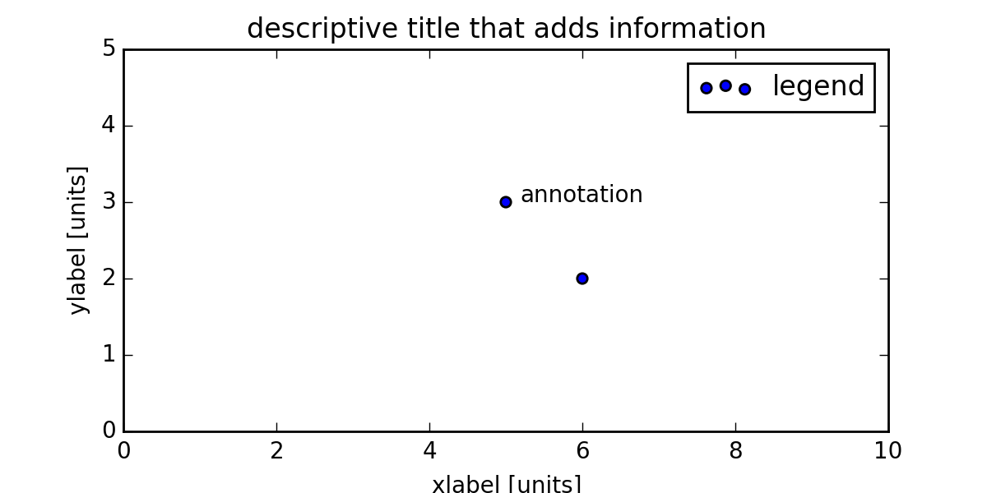
Parts of a Chart
Common parts of a graph that you must consider (if functional)
limits
marker
ticks
tick label
axis

Slide 13
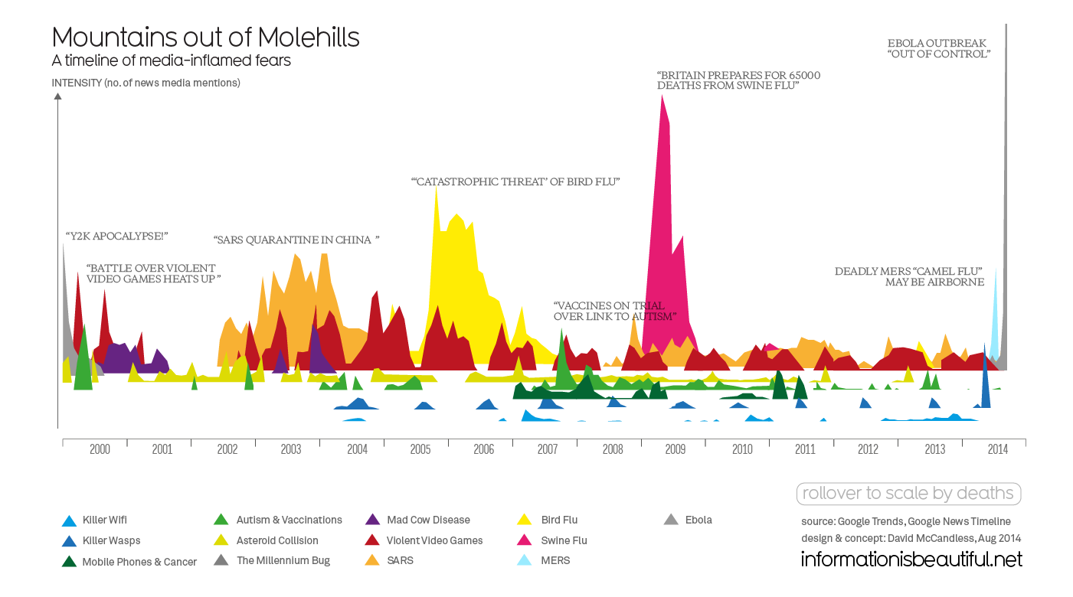
Parts of a Graph?
Notes:
Discuss elements of this graph.
Why is there no X label?
Where is the legend?
Why are the annotations there?
Why are there no ticks on the y-axis?
Is this an infographic or scientific graph?

Slide 14
Chart Types
Scatter Plots,
Line Chart,
Bar Chart / Histogram,
Heat map
Do you know what they are?
More on other types and when to use what in the next few lessons.

Slide 15
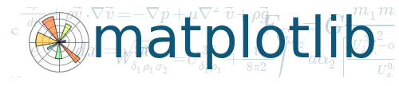
Plotting with Matplotlib
Matplotlib allows for plotting in Python using an easy API. It does not generate the most beautiful plots out-of-the-box.
Still the most popular one.
Alternatives are: Bokeh, Vincent, and ggplot.
http://matplotlib.org/
Notes:
Why? Most used one. Easy API for exploration. Teaches you the terminology for all other plotting libraries.

Slide 16
Assignments 2-5
Practice with scatter and line charts, histograms, and heat maps.
Use the Notebooks in the Git repo as template and add your name and work to the Notebook.
Add everything to you digital portfolio.
Before week 4:
Watch lectures 1a en 2a of the Udacity MOOC Data Visualization and D3.js on Visualization Fundamentals and
Design Principles.

